Slide 1


2025 6th GLOBAL CONFERENCE FOR ADVANCEMENT IN TECHNOLOGY (GCAT 2025)
Semantic-Augmented Prompt-Guided Sketch Filling
for Text-to-SQL Generation
Paper ID: 2839
Kurivella Bala Venkata Mani Kanta
Narasaraopeta Engineering College (Autonomous),
Narasaraopet

Slide 2
Index-
Introduction
Objectives
Literature Survey
Proposed Framework
Model Architecture-
Dataset & Preprocessing
Training Setup
Results AND Dicussion
Result Anaylsis
Conclusion & Future Scope

Slide 3
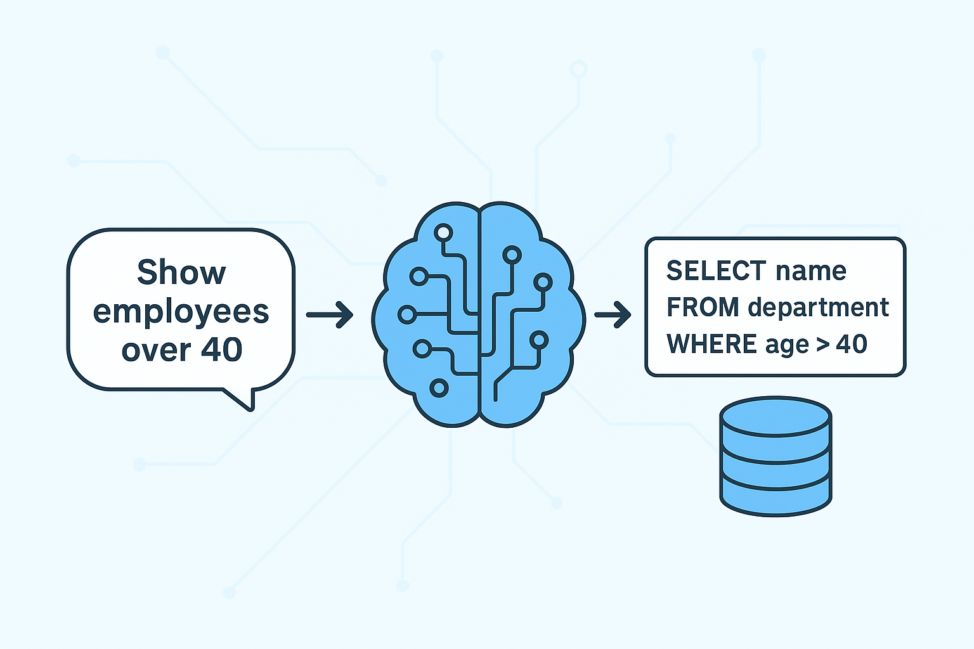
Introduction-
Importance:
Enables non-technical users to query databases using natural language.
Simplifies data retrieval, making it more accessible for analysts, students, and business users.
Essential for intelligent assistants, data analytics, and human–computer interaction.
Challenges in Traditional Methods:
Direct Seq2Seq models often generate invalid or ambiguous SQL queries.
Lack of schema understanding leads to incorrect column or table mapping.
High semantic ambiguity and rigid SQL syntax reduce accuracy.
Motivation:
Need for a model that ensures both syntactic correctness and semantic alignment.
Introduce a Prompt-Guided Sketch Filling approach using T5 to fill predefined SQL templates.
Integrate schema-aware attention for better understanding of relational structures.
Goal:
Achieve high execution accuracy and robust generalization while keeping the model efficient and practical for real-world database querying.

Slide 4
Objectives-
Main Aim:To develop a robust and accurate Text-to-SQL model by integrating Prompt-Guided Sketch Filling with the T5 architecture.
Specific Objectives:
Reduce semantic ambiguity and prevent invalid query generation.
Use SQL sketches (templates) to enforce syntactic correctness.
Integrate structured prompts and schema-aware attention to improve semantic alignment.
Employ a T5 model to fill placeholders in the sketch.
Evaluate performance using Execution Accuracy (EX) and Logical Form Accuracy (LF).

Slide 5
Literature Survey-
Existing Research:
Seq2SQL (Zhong et al.) →Used reinforcement learning for direct query generation but often produced syntactically incorrect queries¹.
SQLNet (Xu et al.) →Introduced a sketch-based (slot-filling) paradigm, improving syntactic accuracy but still struggled with correct column identification².
SQLova (Hwang et al.) → Applied BERT-based contextual embeddings to significantly enhance the system's ability to interpret natural language³.
RESDSQL (Li et al.) → Decoupled schema linking from skeleton parsing, allowing for stronger cross-database generalization⁴.
Gap Identified:
Need for a model that simultaneously:
Resolves semantic ambiguity between the user's question and the database schema⁵⁵⁵⁵.
Guarantees syntactic correctness to prevent invalid query generation⁶⁶⁶⁶.
Integrates the structural discipline of sketches with the contextual power of transformers (T5)⁷⁷⁷⁷.

Slide 6
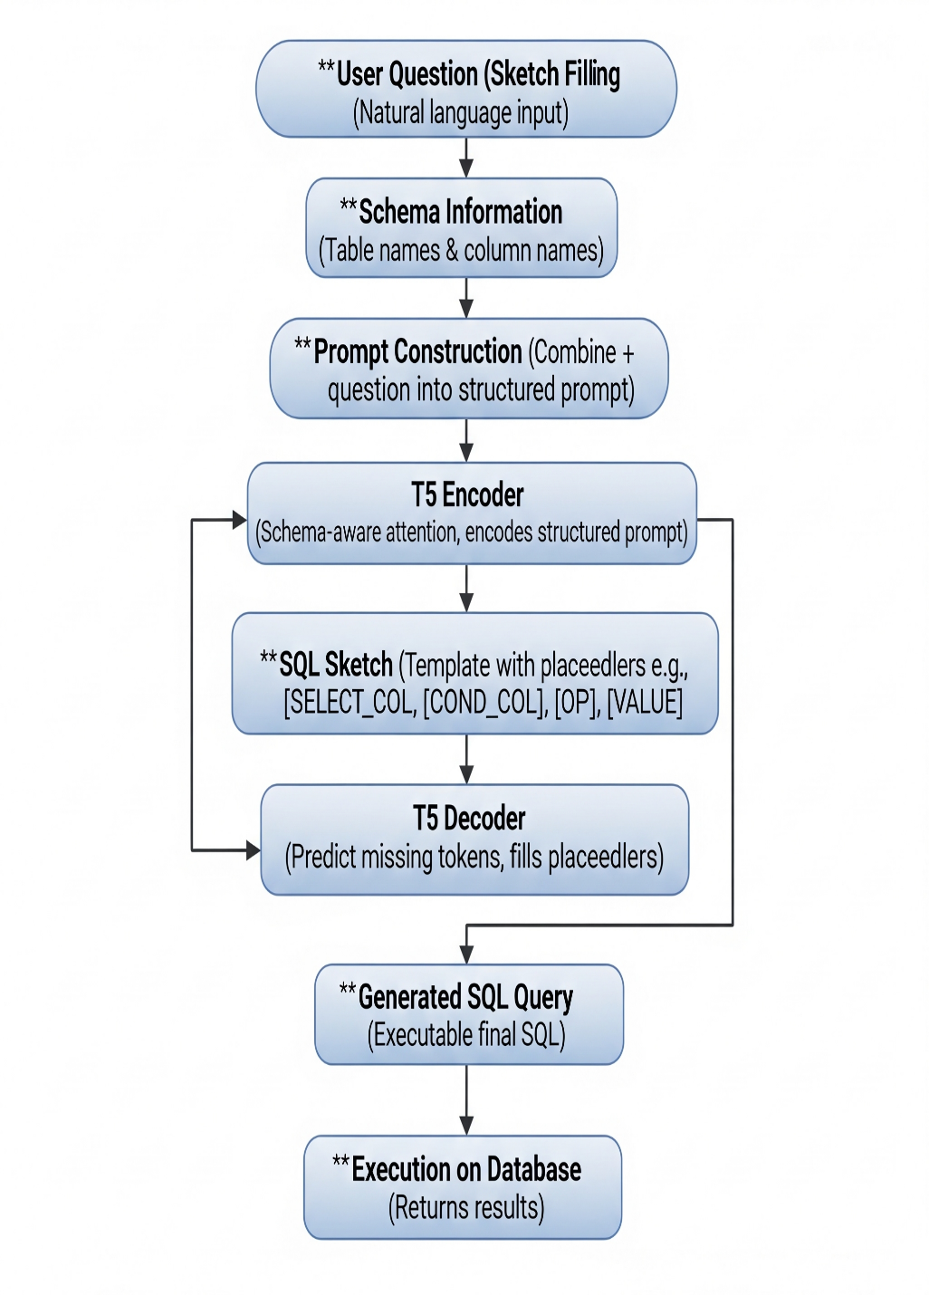
Proposed Framework-
Model Name:
Prompt-T5 - A Prompt-Guided Sketch Filling framework based on the T5 encoder-decoder architecture.
Pipeline Overview:
Input:
User's natural language question.
Database schema (table & column names).
Preprocessing (Prompt Construction):
Combine the question and schema into a structured prompt.
Normalize text (lowercase) and tokenize.
Encoding:
T5 Encoder processes the structured prompt.
Employs schema-aware attention to link the query and schema.
Decoding (Sketch Filling):
Uses a predefined SQL sketch (template) with placeholders (e.g., [SELECT_COL], [COND_COL]).
T5 Decoder predicts missing tokens to fill the placeholders.
Output:
A complete, executable final SQL query.
The query is run on the database to return results.

Slide 7
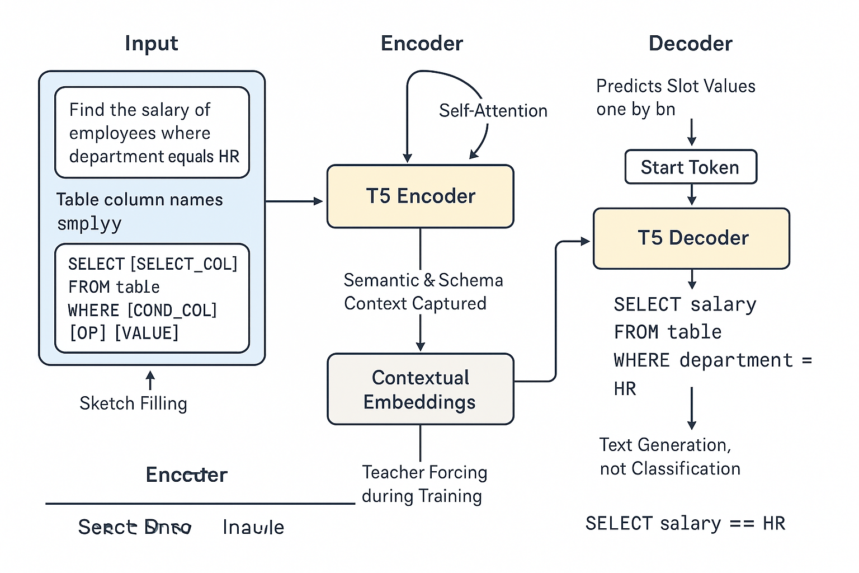
Model Architecture-
Architecture Overview:
Encoder (The "Reader")
Reads the structured prompt (the user's question + table schema).
Uses schema-aware attention to understand which parts of the question relate to which table columns.
Passes this understanding (context) to the Decoder.
Decoder (The "Writer")
Takes the Encoder's context to understand the user's intent.
Its job is to fill in the blanks of the SQL sketch.
It predicts the missing tokens one by one (e.g., name, >, 40) to complete the query.
SQL Sketch (The "Template")
This is a predefined SQL query with placeholders, like:
SELECT [SELECT_COL] FROM table WHERE [COND_COL] [OP] [VALUE]
Main Benefit: This guarantees the final SQL query is syntactically correct because the model isn't writing the structure, just filling the slots.
Architecture Overview:

Slide 8
Dataset & Preprocessing-
Dataset Used:
WikiSQL (Benchmark for Text-to-SQL)
Over 80,000 question-SQL pairs with table schemas
Data Split: 70% Training, 10% Validation, 20% Testing
Preprocessing Steps:
Parse JSON files (train, test, schema)
Normalize Text: Convert to lowercase and separate punctuation
Construct Prompt: Combine question + schema into a structured input
Tokenize: Apply T5 tokenizer to inputs and SQL targets
Pad & Truncate: Ensure consistent sequence lengths for batching
Convert to Tensors: Transform tokens into PyTorch tensors for training
Before Preprocessing | After Preprocessing
{"question": "List Employees Over 40", "sql": "SELECT name FROM department WHERE age > 40", "columns": ["name","age","department"]} | Input: generate sql: list employees over 40 | columns: name, age, department.Output: select name from department where age > 40
Problems: Irregular casing, weak schema mapping, unstructured JSON format. | Improvements: Lowercase text, schema details embedded, consistent spacing, tokenized, and cleaned structure.

Slide 9
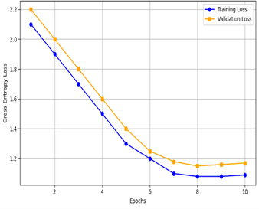
Training Setup-
Training Details:
Framework: PyTorch, using the Hugging Face transformers library.
Model: T5-base (approx. 220 million parameters .
Optimizer: AdamW.
Loss Function: Cross-Entropy Loss.
Learning Rate: 3×10⁻⁴
Epochs: 10 (with early stopping based on validation loss).
Batch Size: 16.
Hardware: NVIDIA RTX 3060 GPU.
Key Observations (from Loss Graph):
Both training and validation loss decrease steadily¹¹.
The model shows stable convergence, stabilizing around epoch 7¹².
The small gap between training and validation loss indicates strong generalization and minimal overfitting¹³.

Slide 10
RESULTS AND DISCUSSION
Performance Comparison: Our proposed model, Prompt-T5, achieves the highest accuracy on the WikiSQL dataset.
We achieved an Execution Accuracy (EX) of 85.1%.
This is a 6.7% improvement over the SQLNet baseline (78.4%) and also outperforms the standard T5 Vanilla model (82.7%).
Our Logical Form (LF) Accuracy was also the highest at 75.4%.
We emphasize Execution Accuracy (EX) as the primary metric, because it measures if the query returns the correct results, which is more important for real-world use than just an exact text match.
Model | LF Accuracy (%) | EX Accuracy (%)
SQLNet [2] | 66.7 | 78.4
Sketch-BERT [9] | 70.5 | 80.2
T5 Vanilla [6] | 72.9 | 82.7
Prompt-T5 (Ours) | 75.4 | 85.1

Slide 11
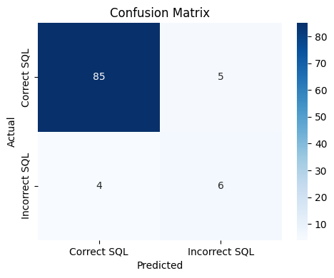
Results Analysis
Ablation Study (Why does our model work?)
We ran tests to validate the contribution of each key component.
Full Model (Prompt-T5): Achieved 85.1% Execution Accuracy.
Model without Sketch Guidance: Accuracy dropped to 82.3%.
Model without Semantic Augmentation: Accuracy dropped to 81.4%.
Conclusion: This confirms that both the prompt design (semantic augmentation) and the sketch framework are crucial for the model's high performance. Error Analysis:
The matrix shows a strong diagonal trend, indicating that most generated SQL queries were correct.
Most errors (off-diagonal entries) occurred with ambiguous phrasing or semantically similar column names.

Slide 12
Conclusion & Future Work
Conclusion:
This study presents a practical framework for translating natural language into valid SQL queries, aimed at making database access easier for non-technical users.
We adopted a Prompt-Guided Sketch Filling approach, where the model completes predefined SQL templates instead of generating queries from scratch.
Using the WikiSQL dataset, the system achieved an execution accuracy of 85.1% and logical form accuracy of 75.4%.
This performance outperforms baseline models such as SQLNet, Sketch-BERT, and the base T5 model.
Ablation experiments confirm that both the prompt-guided sketch structure and semantic augmentation contribute substantially to this improvement.
Future Work:
Enhancing Support for Complex Queries: Extend the framework to handle advanced SQL constructs, including joins, nested subqueries, and grouping.
Strengthening Domain Adaptability: Incorporate advanced schema linking and domain adaptation techniques to improve performance across diverse datasets.
Integrating User Feedback: Develop interactive features that allow user-driven query refinement to enhance usability.
Real-World Deployment: Deploy the framework as a web or mobile platform, enabling non-technical users to interact with databases through natural language.

Slide 13
THANK YOU

